Slide 1
Software Defined Networking using Frenetic
- Gunjan Sharma

Slide 2
What is SDN ?
Software Defined Networking (SDN) provides an abstract layer over the physical network layer. This abstract layer acts as a controller and allows network administrators to have a programmable control of network traffic
SDN is a new network architecture that decouples the software that controls a network from the devices that implement it.

Slide 3
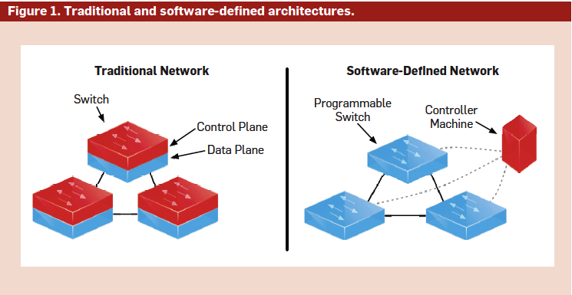
Traditional Network Versus SDN

Slide 4
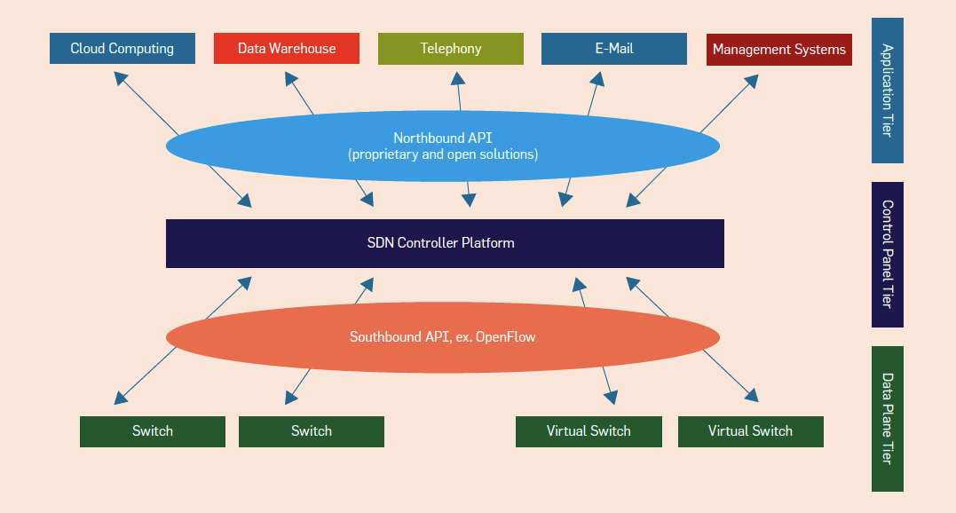
Architecture of SDN

Slide 5
1) Control Plane: The control plane/controller presents an abstract view of the complete network infrastructure, enabling the administrator to apply custom policies/protocols across the network hardware. Ex :The network operating system (NOX) controller is the most widely deployed controller.
2) Northbound Application Interfaces: They are the software interfaces between the software modules of the controller platform and the SDN applications running atop the network platform. These APIs expose universal network abstraction data models and functionality for use by network applications. The “northbound APIs” are open source-based.
3) East-West Protocols: In the case of a multi-controller-based architecture, the East-West interface protocol manages interactions between the various controllers.
4) Data Plane and Southbound Protocols: The data plane represents the forwarding hardware in the SDN network architecture. They are protocols to control and manage the interface between various pieces of network equipment. Ex. OpenFlow protocol.

Slide 6
What is OpenFlow ?
Outcome of Research at Stanford & University of California at Berkeley
OpenFlow is the protocol used for managing the southbound interface of the generalized SDN architecture.
It is the first standard interface defined to facilitate interaction between the control and data planes of the SDN architecture.
The OpenFlow specification is controlled and defined by the nonprofit open network foundation (ONF),

Slide 7
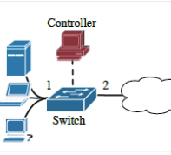
Processing of OpenFlow
Role of Switch
Role of Controller
(Controller Handles only new or unexpected packets)

Slide 8
Problems with OpenFlow
Decoupling is not possible
No higher layer of abstraction is present
Programs are susceptible to subtle network race conditions
Packet handling rules from one module can affect the other

Slide 9
What is Frenetic ?
Frenetic is a language that gives a high level view of OpenFlow networks
Frenetic aims to bridge the gap between OpenFlow networks and their limitations
Advantages :
Declarative design
Modular Design so only limited network-wide effects
race-free semantics

Slide 10
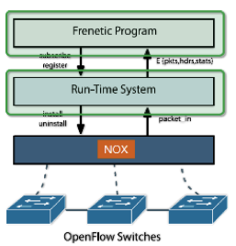
Frenetic continued..
A High-level Language
High level abstraction
Uses Network Query Language
Support for Network Policy Management Libraries
A Run-time System
Supports single tier programming so it “sees every packet on the network”
Deals with asynchronous behavior

Slide 11
Example of Frenetic
def web_query():
return \
(Select (sizes) * Where (inport_fp(2) & srcport_fp(80))) * Every (30))
The first statement indicates that this is a definition of a method named web_query.
The second statement suggests that this method has a return type of stream of integers.
The third statement is a simple SQL type query; it selects all packets arriving on physical port 2 and from TCP source port 80. It sums the sizes of all such packets every 30 seconds and returns the stream of integers. The results of this type of query can be used for traffic analysis, for monitoring security and for decisions regarding forwarding policy. Using the following command we can simply print the results to a printer.

Slide 12
Thank you !

